Slide 1
Mandatory Borrower Training Lead Service Line Inventory Projects
Kentucky Infrastructure Authority
September 25, 2024

Slide 2
Agenda
DWSRF Lead Inventory Basics
Lead & Copper Rule Compliance
Environmental Review Guidelines
Reporting/Record Keeping
Pay Requests

Slide 3
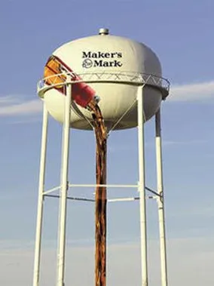
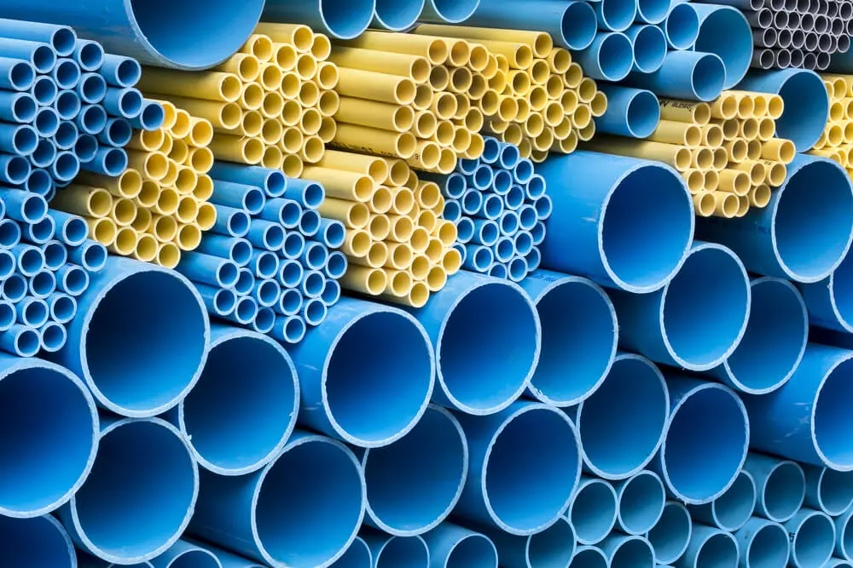
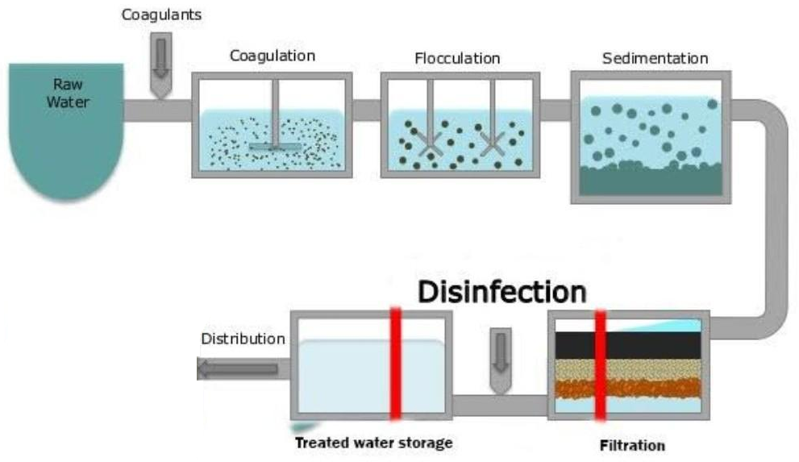
Drinking Water State Revolving Fund
Also called the DWSRF, or Fund F
Low-interest loan program for drinking water infrastructure projects
Purpose is to protect public health & achieve objectives of the Safe Drinking Water Act
Congress appropriates funding, EPA awards capitalization grants to each state

Slide 4
Infrastructure Investment & Jobs Act (IIJA)
Also known as the Bipartisan Infrastructure Law (BIL)
Signed into law 2021
Drinking Water State Revolving Fund - 5 additional capitalization grants
Service line inventory
Lead service line replacement
Ends 2026

Slide 5
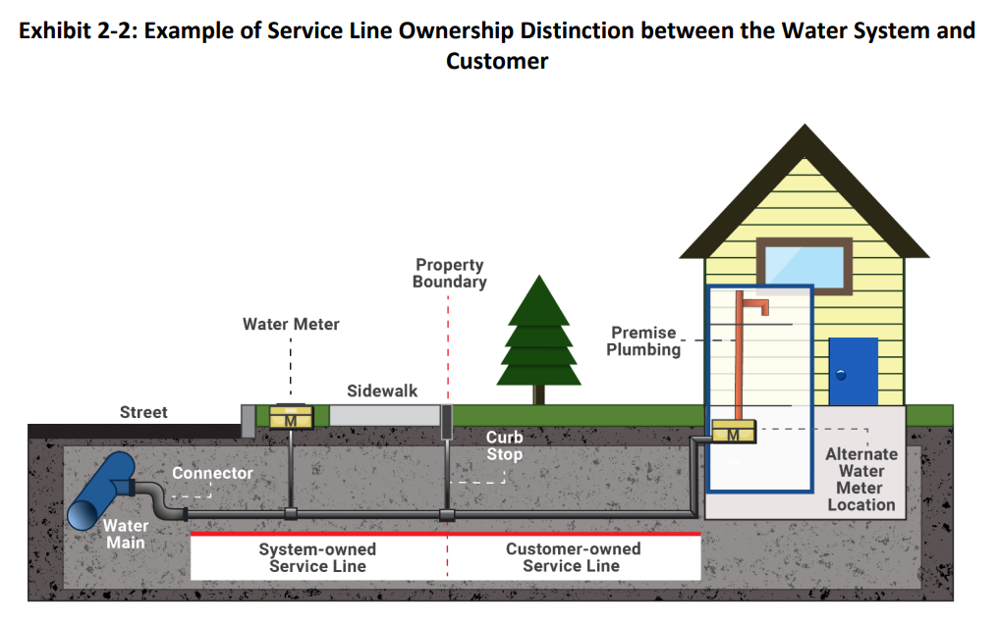
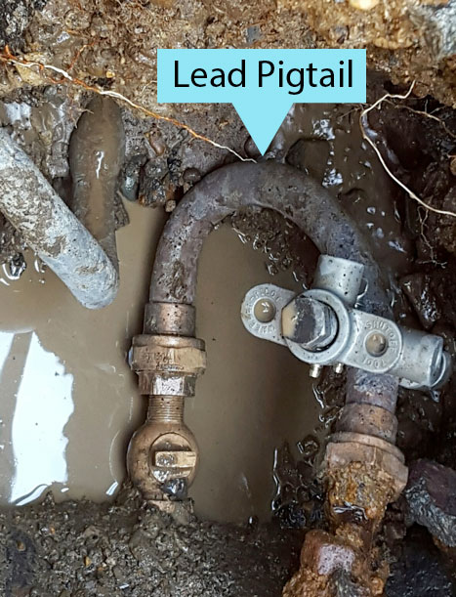

Slide 6
Eligible Uses of DWSRF Lead Fund
Shall otherwise be a DWSRF eligible project, and
Shall be a project or associated activity directly connected to the identification, planning, design, & replacement of lead service lines.
Methods of investigation to develop inventories include:
visual observation, water quality sampling (non-compliance), excavation, vacuum or hydro-excavation, statistical analysis, and emerging technologies

Slide 7
Safe Drinking Water Act

Slide 8
Procurement & Reporting

Slide 9
Pay Requests

Slide 10
Project Closeout

Slide 11
Contacts
Carmen Ignat
502-892-5844
carmenv.ignat@ky.gov
Debbie Landrum
502-892-3454
debbie.landrum@ky.gov
Don Schierer
502-892-3486
donald.schierer@ky.gov
Julie Bickers
502-892-3455
julie.bickers@ky.gov
Kelly Cunnagin
502-892-3178
kelly.cunnagin@ky.gov
Milward Dedman
502-892-3179
milward.dedman@ky.gov
Russell Neal
502-892-3030
russells.neal@ky.gov

Slide 12
Q & A
Thank you for attending.

