Slide 1
Cleaner Water Program Grants Completing Your Assistance Agreement
Kentucky Infrastructure Authority
August 13, 2024

Slide 2
Agenda
Presentation on Assistance Agreement Process
Question and Answer with KIA Grant Team

Slide 3
Funding Appropriations – Kentucky General Assembly
Senate Bill 36 – 2021 Regular Session
Invest federal relief funds in water & sewer infrastructure (ARPA)
200 KAR Chapter 17:111
Grants allocated 3 ways:
County population
Drinking water service to unserved, rural customers or utilities under Consent Decree
Supplemental
House Bill 1 – 2022 Regular Session
Additional round of funding
Allocated by county population

Slide 4
Deadlines
All projects must have an executed Assistance Agreement by
September 1, 2024
Grant funds must be spent by
December 31, 2026

Slide 5
Who’s Who
GRANTEE
Governmental agency
This entity was awarded an amount of CWP funds
AUTHORIZED OFFICIAL
Individual specifically designated by the Grantee
Sign documents & takes official actions for and on behalf of the Grantee
PROJECT ADMINISTRATOR
Qualified individual specifically engaged by the Grantee’s Authorized Official
Oversees and expedites completion of the administrative tasks and duties of the Project
Principal contact with KIA relating to the Grantee’s CWP Project.
ENGINEER
Engineer licensed in Kentucky properly procured by the Grantee
Assists with initial project planning, engineering design, development of construction plans and specifications, project bidding, oversight of construction contracting services between the Grantee and the selected construction contractor.

Slide 6
Exhibits Required to Execute Assistance Agreement
Exhibit 1: Certification of Project Profile
Exhibit 2: Vendor Registration
Exhibit 3: Transparency Act
Exhibit 4: Resolution (Round 1 & Round 2)
Exhibit 5: Opinion of Legal Council
Exhibit 6A: Engineering Services
Exhibit 6B: Grantee & Engineering Fee Confirmation
Exhibit 7: eClearinghouse
Exhibit 8: DOW Plans & Specs Approval Letter
Exhibit 9: Bid Package
Exhibit 10: Utility Accounting Certification

Slide 7
Getting Started
GRANTEE works with PROJECT ADMINISTRATOR to complete Exhibits 1, 2, & 3
GRANTEE signs Conditional Commitment Letter
PROJECT ADMINISTRATOR sends the following to KIA:
Conditional Commitment Letter
Completed Exhibits 1, 2, & 3
Project Budget Form

Slide 8
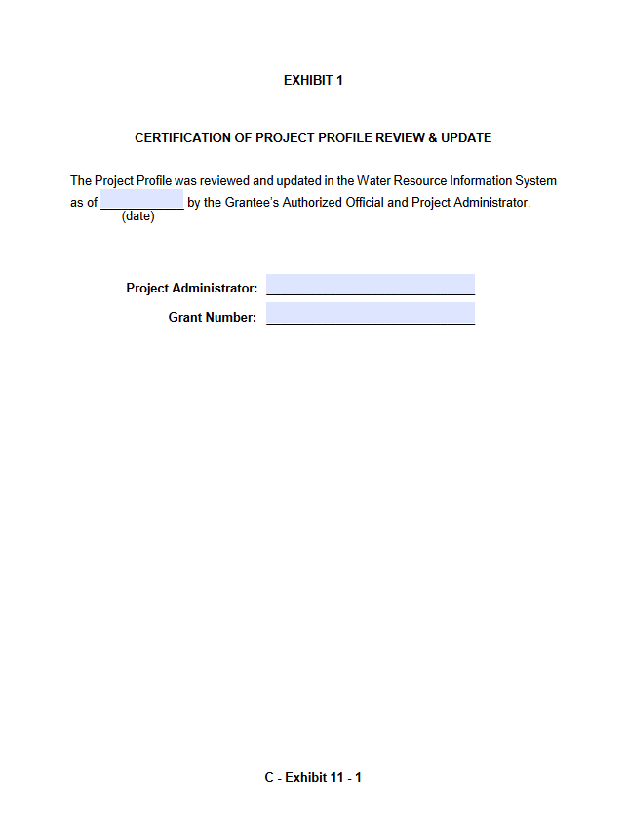
Exhibit 1: Certification of Project Profile
GRANTEE works with PROJECT ADMINISTRATOR to complete
Review & update WRIS Project Profile data
Narrative
Applicant
Administration
Budget & Schedule
Impacts
Components
Sustainable Infrastructure
Map

Slide 9
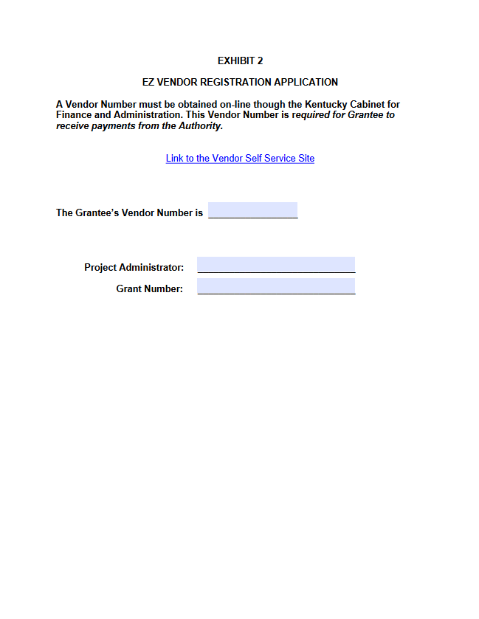
Exhibit 2: Vendor Registration
GRANTEE works with PROJECT ADMINISTRATOR to complete
Link to Vendor Registration HERE
Registration is required for grantee to receive payments from KIA

Slide 10
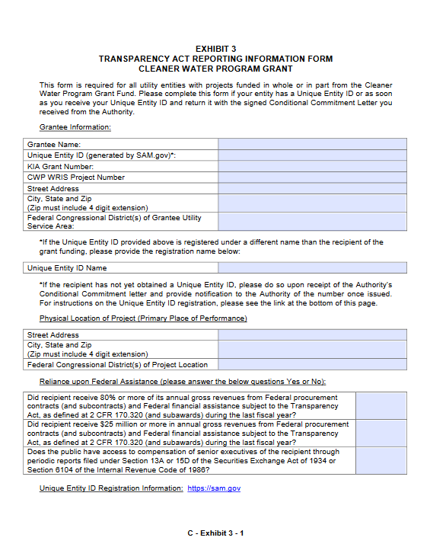
Exhibit 3: Transparency Reporting
GRANTEE works with PROJECT ADMINISTRATOR to complete
Link to System for Award Management, SAM.gov HERE
Need Help? Contact your Area Development District or Chris Wells with Great Lakes Community Assistance Partnership of Kentucky cawells@glcap.org
May take a week or longer after submitting application to receive your SAM ID

Slide 11
Next Steps
KIA verifies Exhibits & forwards unsigned Assistance Agreement to GRANTEE
GRANTEE adopts and completes Exhibit 4 at a regular or special meeting of the GRANTEE’S legal body
Legal counsel reviews Exhibit 4 and signs Exhibit 5
AUTHORIZED OFFICIAL signs the Assistance Agreement
PROJECT ADMINISTRATOR returns signed Assistance Agreement and completed Exhibits 4 and 5 to KIA

Slide 12
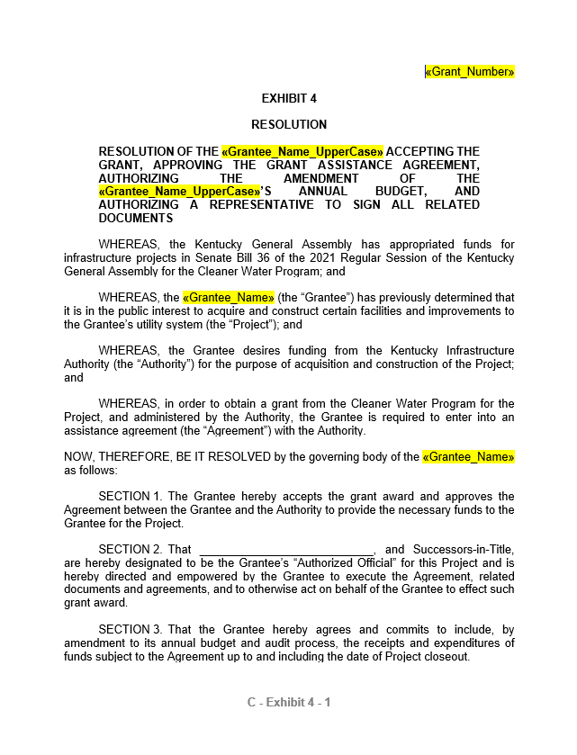
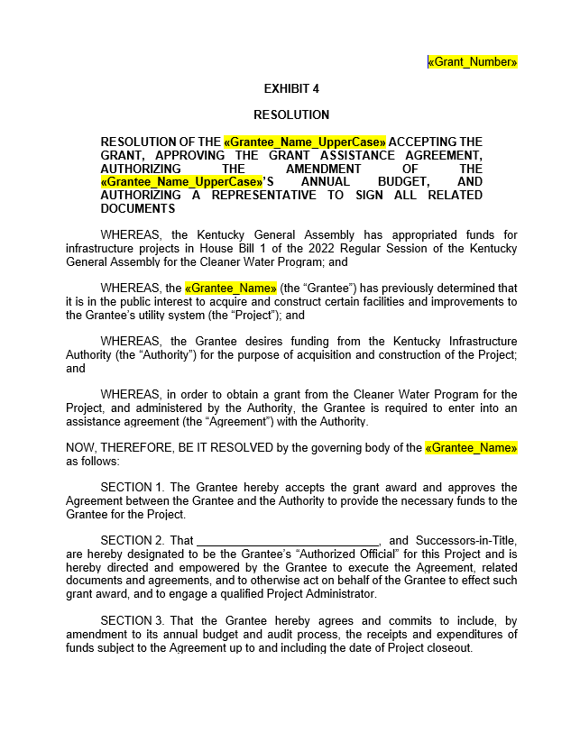
Exhibit 4: Resolution
Make sure to use the correct document
2021 grants use Senate Bill 36 Resolution
2022 grants use House Bill 1 Resolution
Send to KIA along with the Assistance Agreement and Exhibit 5
IMPORTANT: Date of the Resolution must be on or after the date you received the grant agreement

Slide 13
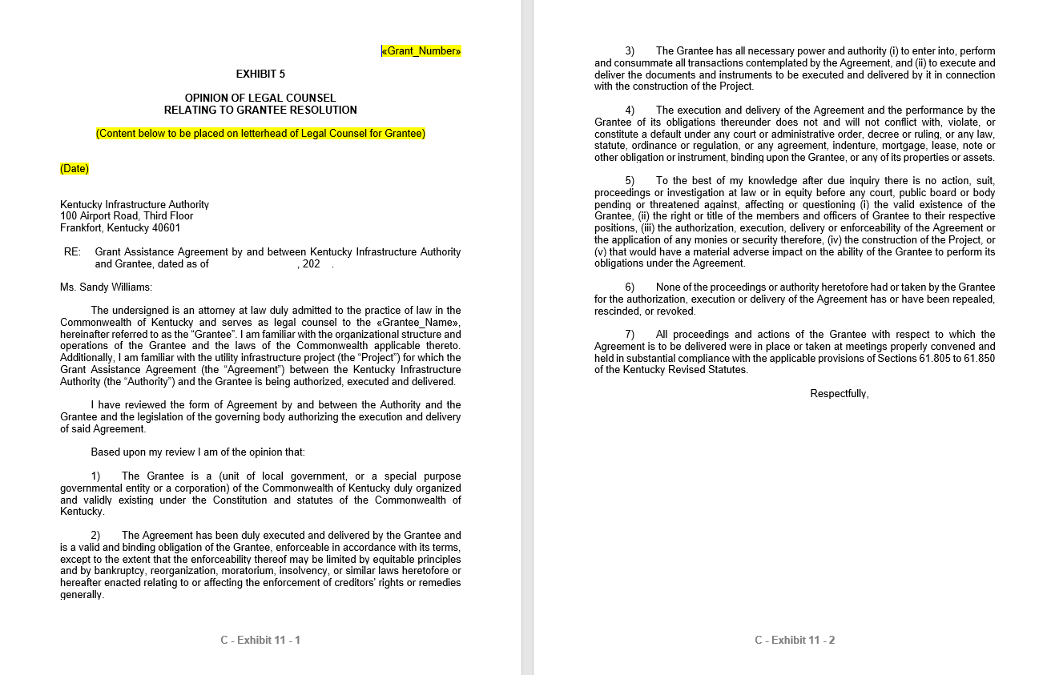
Exhibit 5: Opinion of Legal Counsel
Send to KIA with Assistance Agreement and Exhibit 4

Slide 14
Next Steps
PROJECT ADMINISTRATOR submits project to eClearinghouse for review
AUTHORIZED OFFICIAL signs Utility Accounting Certification
Utility Accounting Certification, & eClearinghouse endorsement letter are sent to KIA
KIA signs Assistance Agreement and sends copy to GRANTEE

Slide 15
Exhibit 7: eClearinghouse
PROJECT ADMINISTRATOR submits project to eClearinghouse & forwards endorsement letter to KIA

Slide 16
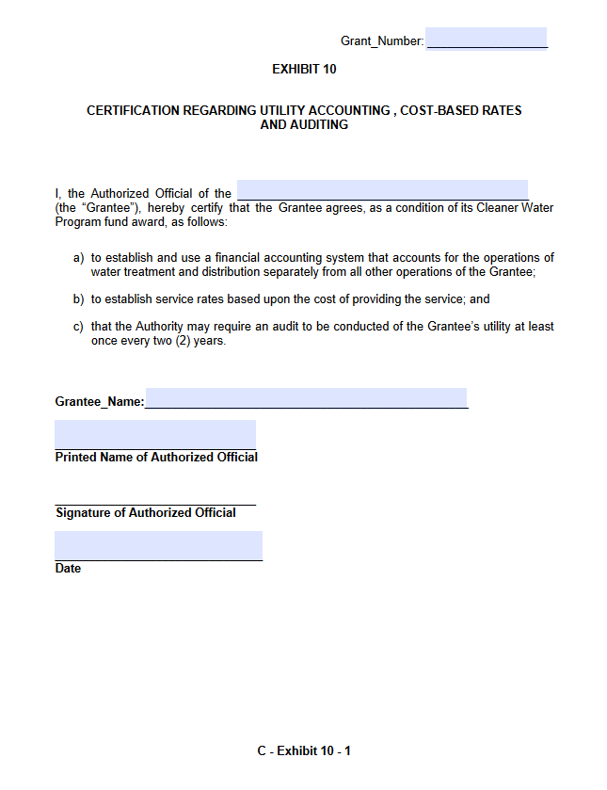
Exhibit 10: Utility Accounting Certification
AUTHORIZED OFFICIAL signs & sends to KIA

Slide 17
Summary
Exhibits 1, 2, 3, 4, 5, 7, and 10 must be submitted to KIA to execute the Assistance Agreement
Link to exhibits on KIA’s website HERE
Grantees without an executed Assistance Agreement by September 1, 2024 jeopardize losing funds
Grant funds must be fully spent by December 31, 2026

Slide 18
KIA Contacts
Carmen Ignat
502-892-5844
carmenv.ignat@ky.gov
Debbie Landrum
502-892-3454
debbie.landrum@ky.gov
Don Schierer
502-892-3486
donald.schierer@ky.gov
Julie Bickers
502-892-3455
julie.bickers@ky.gov
Kelly Cunnagin
502-892-3178
kelly.cunnagin@ky.gov
Milward Dedman
502-892-3179
milward.dedman@ky.gov
Russell Neal
502-892-3030
russells.neal@ky.gov

Slide 19
Q & A
Thank you for attending.

