Slide 1
WRIS Project Profile and Call for Projects

Slide 2
The State Revolving Fund
Clean water (CWSRF)/Fund A and drinking water (DWSRF)/Fund F
Low-interest loan program for infrastructure projects
Purpose is to protect public health & achieve objectives of the
Clean Water Act and Safe Drinking Water Act
Bipartisan Infrastructure Law (BIL) - 5 additional capitalization grants
CWSRF – Supplemental & Emerging Contaminants
DWSRF – Lead, Supplemental, & Emerging Contaminants
Ends federal fiscal year 2026

Slide 3
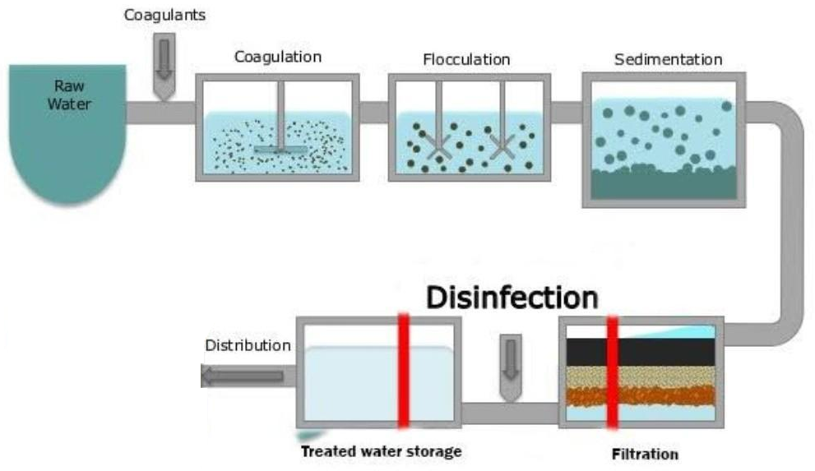
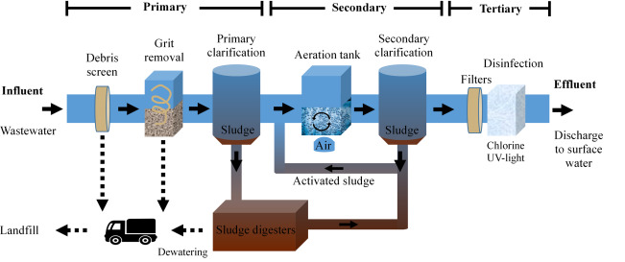
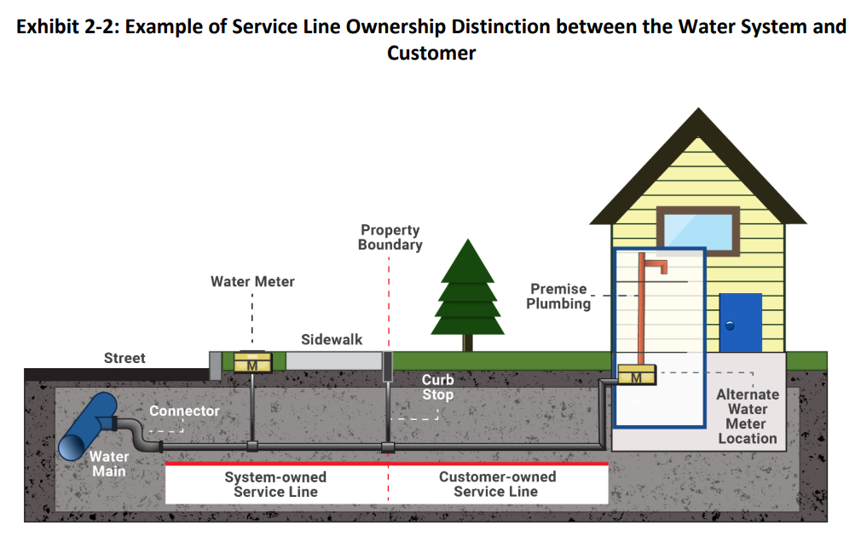
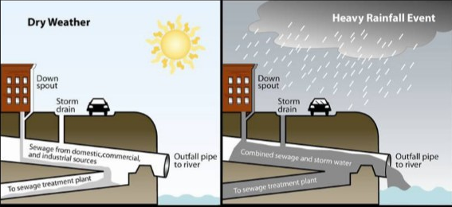
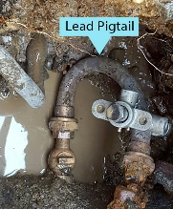
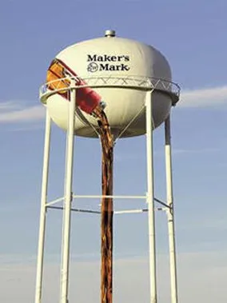
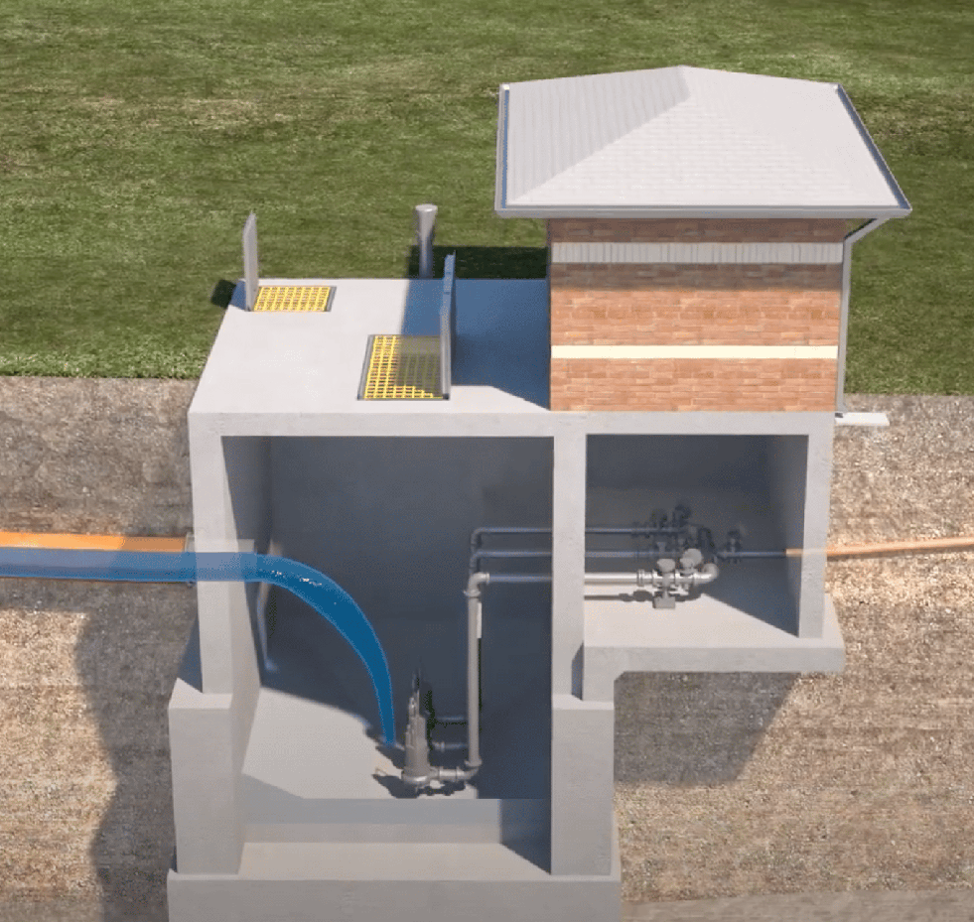
0
Drinking Water Treatment
Sewer Treatment
Sewer Overflow
Lead Service Line Inventory & Replacement

Slide 4
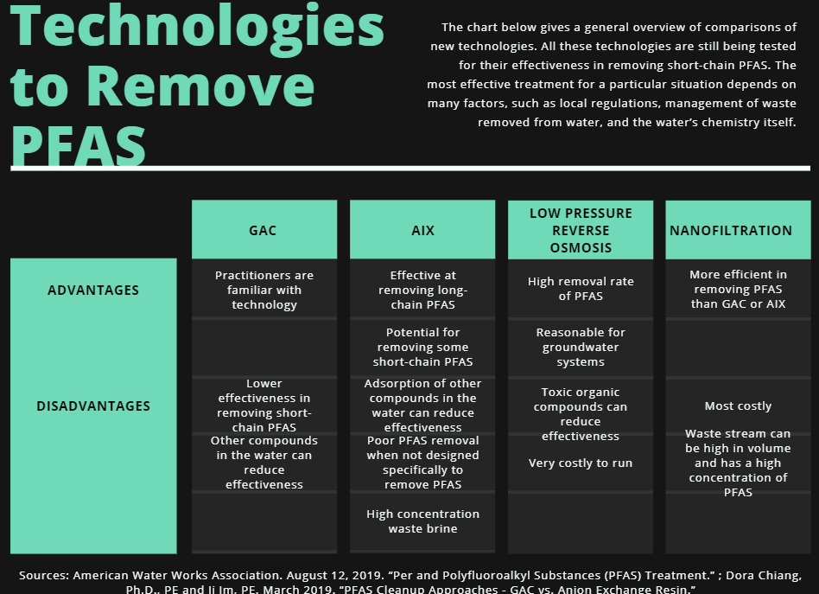
Per- & polyfluoroalkyl substances (PFAS)

Slide 5
Eligibilities
Governmental Agencies
City
County
Water and Sewer/Sanitation District
Water Association
Water Commission
For the CWSRF or DWSRF Programs, the project MUST BE listed on the SRF Priority List
DWSRF Projects Primarily for Growth or Fire Suppression

Slide 6
SRF Priorities
CWSRF
DWSRF
Disadvantaged Communities
Regionalization
Compliance
Sustainable Infrastructure
Project Readiness
Security
Planning
Project Needs
Water Quality
PFAS
Public Health
Lead
PFAS

Slide 7
SRF Call for Projects & Ranking Process Schedule
July – Sept. | Sept. – Dec. | Dec. – Jan. | Jan. – Feb. | Feb. – Mar. | April – May | May – June
Update SRF Criteria | Call for Projects Announcement | Preliminary Project Profile Review | Review & Respond to DOW/KIA Comments | DOW Personnel Completes Final Scoring and Ranking | IUP Draft | Public Meeting
Update WRIS Project Profile & Pre-Application Form | Training & Outreach | Preliminary Project Profile Review | Coordinate Profile Updates | Coordinate Follow-Up Questions as Needed | Public Comment Period | Final IUP
Upload Updated Guidance & Forms to WRIS | Create, Complete, Update, & Submit Projects | Update WRIS MHI with ACS Data | Forward Comments & Responses to DOW | KIA | KIA | Loan Invitation
Notify ADDs of Guidance & WRIS updates | Verify Submission | Email Preliminary Review Spreadsheets | KIA | KIA | KIA | KIA
KIA | Final Call for Projects Check-in | KIA | KIA | KIA | KIA | KIA
KIA | Area Development District |  | Division of Water | Kentucky Infrastructure Authority |  | KIA

Slide 8
SRF Guidance Documents Updates
Adjustments to CWSRF and DWSRF Priority System
CWSRF
Regionalization, replacing or eliminating failing package treatment plants
Eliminating failing septic tanks
Disadvantaged communities
DWSRF
Addressing PFAS through regionalization, source water protection, potable water supply, and treatment
Distribution system infrastructure
Lead Compliance
Security
Disadvantaged communities
Planning

Slide 9
WRIS Project Profile
from Guidance Document to Proposed GIS Mapping
DOW
Guidance Documents
CW / DW
Project Profile Pre-Application
CW / DW
Project Profile
Proposed
GIS Mapping

Slide 10
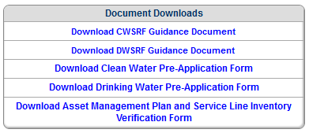
WRIS Pre-Application
https://wris.ky.gov/portal/PrjData
DOW
CW Guidance Document
DW Guidance Document
WRIS
CW Pre-Application
DW Pre-Application

Slide 11
Clean Water Project Profile Pre-Application
Planning Needs
Mapping Requirements CWSRF Ranking Criteria
Replacement or Rehabilitation of Aging Infrastructure (Points Received: 50)
(GIS) - Must have mapping for proposed line(s) and set ACTIVITY to REHAB - CIPP LINING, REHAB - CLEANING, REHAB - REPLACE OBSOLETE OR AGING
LINES, REHAB - PIPE BURSTING, REHAB - REPLACE PROBLEM LINES, REHAB - SLIP LINING, or REHAB - REPLACE UNDERSIZED LINES; and /or have mapping
for proposed point(s) (except SEWAGE TREATMENT PLANT, SCADA, or OTHER) and set STATUS to REHAB
Mapping Requirements (GIS)
key words: set ; to; and /or

Slide 12
Planning Needs
Combined Sewer Overflow (CSO) Correction.
Sanitary Sewer Overflow (SSO) Correction.
Replacement or Rehabilitation of Aging Infrastructure.
New Treatment Plant.
New Collector Sewers and Appurtenances.
Decentralized Wastewater Treatment Systems.
Upgrade to Advanced Treatment.
This project addresses PFAS or other emerging contaminants.
Rehab/Upgrade/Expansion of Existing Treatment Plant.
New Interceptor Sewers and Appurtenances.
Stormwater Control.
Non-Point Source (NPS) Pollution Control.
Recycled Water Distribution.
Planning
Other (specify):

Slide 13
GIS Proposed Mapping Attributes
Attributes
Values

Slide 14
Drinking Water Project Profile Pre-Application
Water Line Replacement
Mapping Requirements DWSRF Ranking Criteria
This project replaces problem water lines (breaks, leaks, or restrictive flows due to age), water lines consisting of asbestos-cement (AC), and/or inadequately sized water lines. (Points Received: 10 for up to first 1000 LF plus 2 pts for each additional 1000 LF, Max: 50 pts)
This project replaces lead service lines (Points Received *)
Total number of lead service line replacements:
(GIS) - Must have mapping for proposed line(s) and set ACTIVITY to REHAB - REPLACE PROBLEM LINES or REHAB - REPLACE LEAD AND/OR ASBESTOS-CEMENT LINES or REHAB - REPLACE UNDERSIZED LINES
(GIS) - Must have mapping for proposed point(s). Set TYPE to LSL, STATUS to REHAB, and PURPOSE to REPLACEMENT for each location of LSL replacement.
Mapping Requirements (GIS)
key words: set ; to; and /or

Slide 15
Components and Proposed Mapping Attributes
Water Line Replacement
This project replaces problem water lines (breaks, leaks, or restrictive flows due to age), water lines consisting of lead and/or asbestos-cement (AC), and/or inadequately sized water lines.
Total length of line replacement: 13,208 LF
In-place or in-situ repair methods will be used in lieu of water line replacement.
This project replaces lead service lines.
Total number of lead service line replacements: 25
One or more homeowners have declined lead service line replacement
automated

Slide 16
Components and Proposed Mapping Attributes
Filled in programmatically
based on Proposed Mapping by GIS Analyst

Slide 17
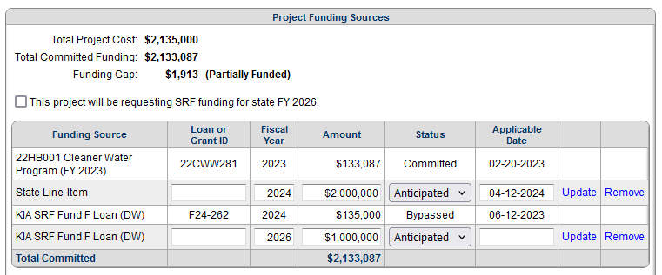
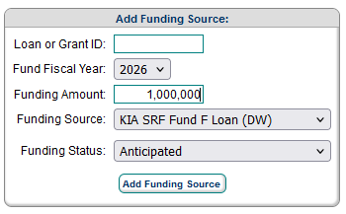
CFP and Budget & Schedule
This Project will be requesting SRF funding for state FY 2026.

Slide 18
Questions

Slide 19
WRIS

Slide 20
WRIS Portal
System Data
GIS
WRIS Portal
Project Profile
Notes:
There are 3 major components of the WRIS Portal
There’s:
System Data
Project Profile
GIS Mapping

Slide 21
WRIS Portal
System Data
WRIS Portal
Notes:
There are 3 major components of the WRIS Portal
There’s:
System Data
Project Profile
GIS Mapping

Slide 22
WRIS Portal: System Data
https://wris.ky.gov/portal/SysData
System Data
Utility/System information
Updated annually during ADD system visits
Contact Information
System Statistics
Production statistics
Serviceable Population
Service area weighted MHI
Connection counts
Rates
Asset Management Tools
System Maintenance & Policy Checks
GIS Web Map of System (Existing)
Water/Wastewater Lines
Pump/Lift Stations
Treatment Plants
Water Tanks
Master Meters
Intake/Outfalls
Notes:
System data includes the utility information such as contact information that is updated annually during ADD system visits.

Slide 23
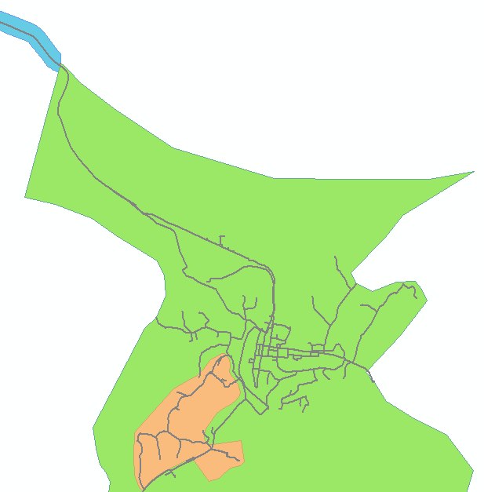
Asset Management Tab
https://wris.ky.gov/portal/DwSysData/KY0880452
Information pulled from the GIS
ADDs worked with each utility to create Assessment Areas that divide up each system
Assets can be graded based on:
Condition, Performance, & Priority
Zone 1
Zone 2
Zone 3
Notes:
In the system data you are going to see a tab called Asset Management. The information you see here is pulled from the GIS thanks to the ADDs who worked with each utility to create what we call assessment areas. These assessment areas divide each system into zones that we can populate with the various assets located there. Assets can be graded based on condition, performance, and priority.

Slide 24
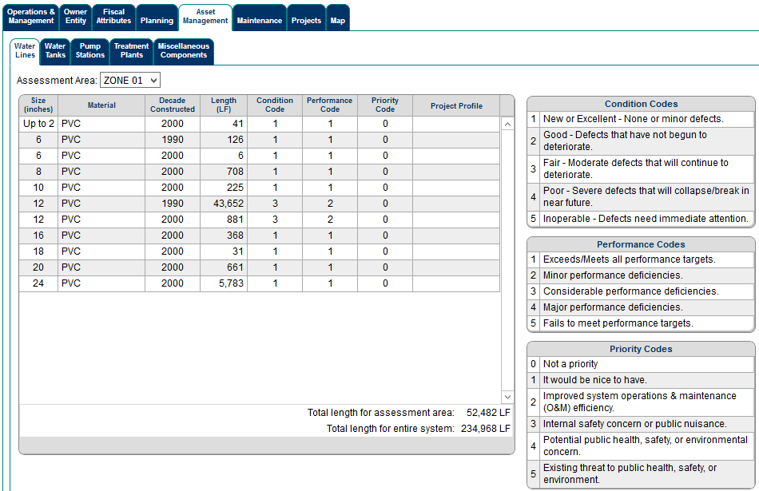
Asset Management Tab
https://wris.ky.gov/portal/DwSysData/KY0880452
Zone 1
Zone 2
Zone 3

Slide 25
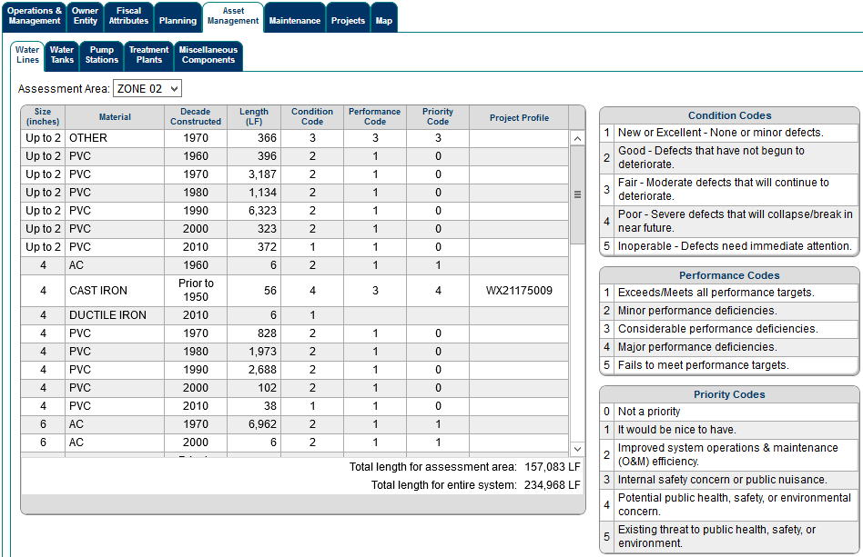
Asset Management Tab
https://wris.ky.gov/portal/DwSysData/KY0880452
Zone 1
Zone 2
Zone 3

Slide 26
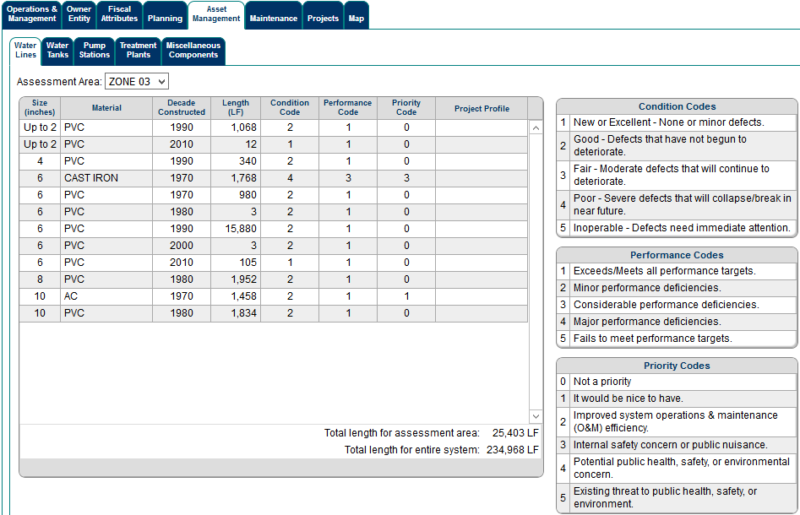
Asset Management Tab
https://wris.ky.gov/portal/DwSysData/KY0880452
Zone 1
Zone 2
Zone 3

Slide 27
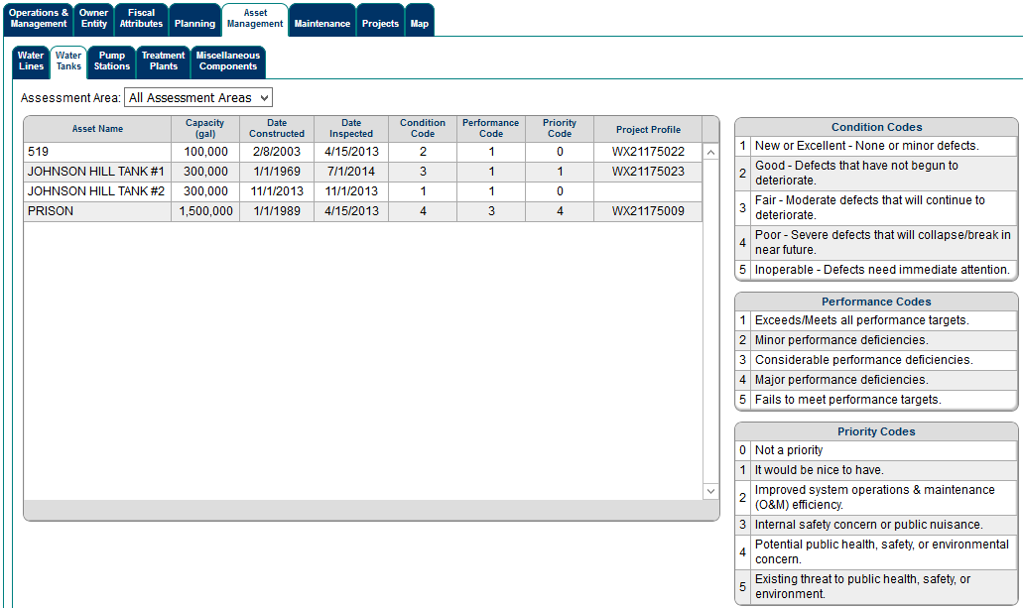
Asset Management Tab
https://wris.ky.gov/portal/DwSysData/KY0880452
Zone 1
Zone 2
Zone 3

Slide 28
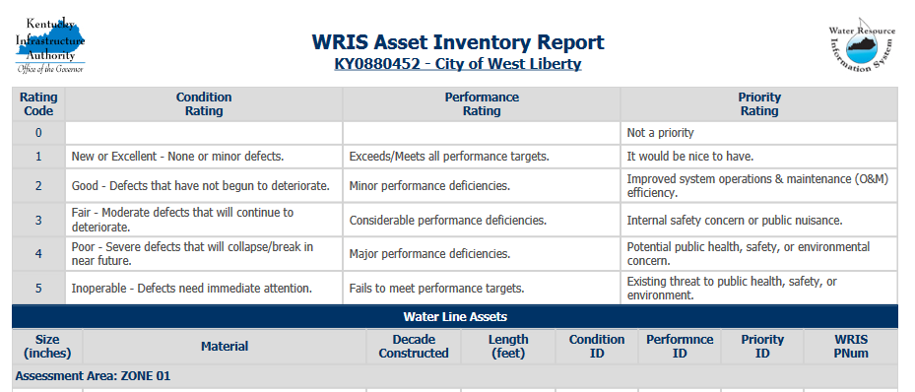
Asset Management Tab
https://wris.ky.gov/portal/DwSysData/KY0880452
Downloadable Reports

Slide 29
WRIS Portal: System Data
https://wris.ky.gov/portal/SysData
How is all of this data updated and maintained?
KY Area Development Districts conduct yearly system visits with each utility
GIS Feature Datasets -- Existing Wastewater and Existing Water
Database links with state agencies
Division of Water / Department of Local Government
GIS Layer Overlays
Census Overlays
Demographics / MHI
GIS recorded data
Wholesale volumes and cost / Production statistics
Notes:
System data includes the utility information such as contact information that is updated annually during ADD system visits.

Slide 30
WRIS Portal
WRIS Portal
Project Profile
Notes:
There are 3 major components of the WRIS Portal
There’s:
System Data
Project Profile
GIS Mapping

Slide 31
WRIS Portal: Project Profile
https://wris.ky.gov/portal/PrjData.aspx
Project Profile
Project planning
Any project looking for state or federal funding
Organic & always evolving
Projects seeking SRF are scored and ranked by KY Division of Water review process
Profiles feed Kentucky’s eClearinghouse and SRF electronic applications
eClearinghouse is a web interface so state agencies can review and comment on projects seeking state and federal funding (not limited to water/wastewater)
Notes:
Project Profile consists of project planning and projects looking for state and federal funding.
Projects are organic so the profiles are always changing.
Projects in the portal that are seeking SRF funding are scored and ranked through a Division of Water review process.
And profiles feed Kentucky’s eclearinghouse and SRF electronic applications.

Slide 32
WRIS Portal: Project Profile
https://wris.ky.gov/portal/PrjData.aspx
Project Profile Creation
Profile created by the ADD Water Management Coordinator
Generates WX # (water projects) or SX # (wastewater projects)
WX21053017 | SX21059056
Profile contains:
Narrative
Applicant
Project Administrator
Project Engineer
Budget & funding sources
Proposed mapping

Slide 33
WRIS Portal: Project Profile
https://wris.ky.gov/portal/PrjData.aspx
SRF Project Profile Process
Profiles voted on by ADD Water Management Councils
Once approved, can seek funding
SRF projects reviewed and ranked by KY Division of Water electronically
Potential borrowers are electronically invited for a loan based on rankings
If a borrower accepts the invitation, KIA generates an electronic application that is based on the project profile

Slide 34
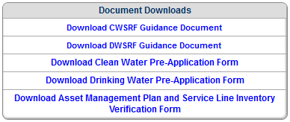
WRIS Portal: Project Profile
https://wris.ky.gov/portal/PrjData.aspx
How is this data updated and maintained?
KY ADDs work with utilities and project engineers on a routine basis
GIS Feature Dataset -- Proposed
Database links with various state agencies
KY Division of Water
KY Department for Local Government
KY Board of Engineers
GIS Layer Overlays
Profile pre-application document
Fillable PDF of Project profile CW Project Profile Pre-Application and DW Project Profile Pre-Application
note mapping requirements for specific checkboxes (GIS) - Must have mapping for proposed point(s) and…
KY Division of Water CWSRF Guidance Document and DWSRF Guidance Document.

Slide 35
WRIS Portal: Project Profile
https://wris.ky.gov/portal/PrjData.aspx
Who has access to project profiles
Publicly viewed
Edited only by the ADDs
Any & all profiles changes must go through the ADD or KIA
Once a project is submitted for SRF (through a checkbox on the profile) or submitted to eClearinghouse, the profile becomes locked.
ADDs no longer can edit profiles without KIA approval

Slide 36
WRIS Portal
GIS
WRIS Portal
Notes:
There are 3 major components of the WRIS Portal
There’s:
System Data
Project Profile
GIS Mapping

Slide 37
WRIS Portal: GIS
GIS
Project Mapping for each profile
Map view of where projects are proposed to be constructed/rehabbed
GIS Feature Dataset – Proposed Mapping
System Mapping
Map view of where existing infrastructure already exist
GIS Feature Dataset – Wastewater and Water
Heavily integrated into the System Data and Project Profiles
Demographics / MHI analysis performed in the WRIS
Asset Management
Components
Notes:
The third component is GIS.
We have proposed project mapping for each profile.
We have existing mapping for each system.
GIS is heavily integrated into the Demographics and MHI analysis that we perform.

Slide 38
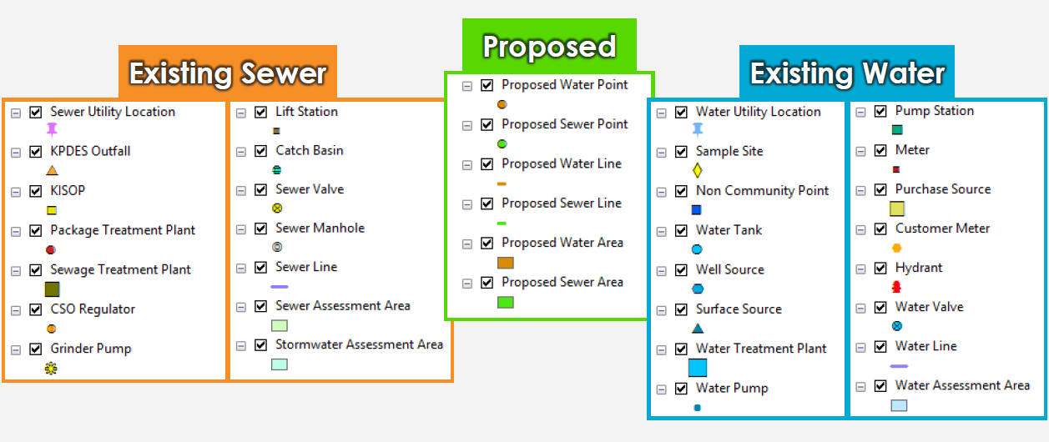
WRIS Portal: GIS
What do we collect/maintain?

Slide 39
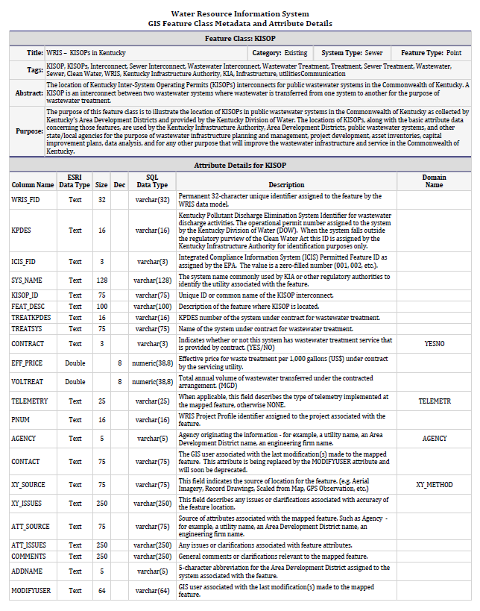
WRIS Portal: GIS
WRIS Feature Attribute Details
Description and Domain Name for features
Line size, material (Dropdown Items)
Water tank capacity
Average million gallons per day treated

Slide 40
WRIS Portal: GIS
WRIS Feature Attribute Details
Field Name, Domain Name
Domain Values (Dropdown List)
Line size, material Water tank capacity
Average million gallons per day treated
TYPE - WPROPTYPE
CHLORINE BOOSTER STATION
DEBT SERVICE
GENERATOR
GRR
HYDRANT
INTERCONNECT METER
LSL
MASTER METER
PUMP STATION
RADIO METER
SCADA
SECURITY
SOURCE WATER PROTECTION
SURFACE SOURCE
TRADITIONAL METER
VALVE
WATER PUMP
WATER TANK
WATER TREATMENT PLANT
WELL SOURCE
OTHER
STATUS - WPROPSTAUS
AMR – UPGRADE
ELIMINATE
NEW
REHAB
REPLACE – DECOMMISSION
REPLACE – NEW
WTP – EXPANSION
WTP - UPGRADE
UNITS PROPUNITS
GALLONS
GPD
GPM
MGD
EXST_CAP / PROP_CAP
RANGE: 0.0 – 1000000000

Slide 41
WRIS Portal: GIS
How do we collect and maintain GIS Data?
Software we use to map is ArcMap / ArcGIS Pro – developed by Esri
Each ADD has an ArcMap software license
Proposed maps are prepared by engineers and given to the ADDs to be drawn into a database
These feed project profiles that are associated with specific SX # or WX #
Utilities provide as-builts after project completion for new existing infrastructure
ADDs work with each utility to map their infrastructure
GPS Collection
Provide updated wall maps & map books* to each utility every year (printed or digital)
For utilities with GIS capabilities, data is provided to the ADD or directly to KIA

Slide 42
WRIS Portal: GIS
Examples
Project Profile
Project Profile Map
System Data
System Data Map

Slide 43
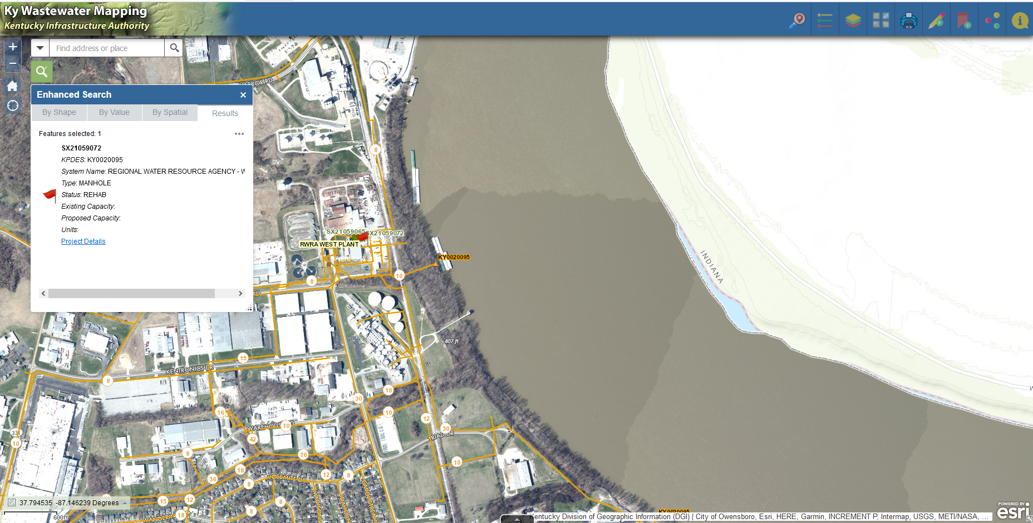
Notes:
Turn off existing sewer

Slide 44
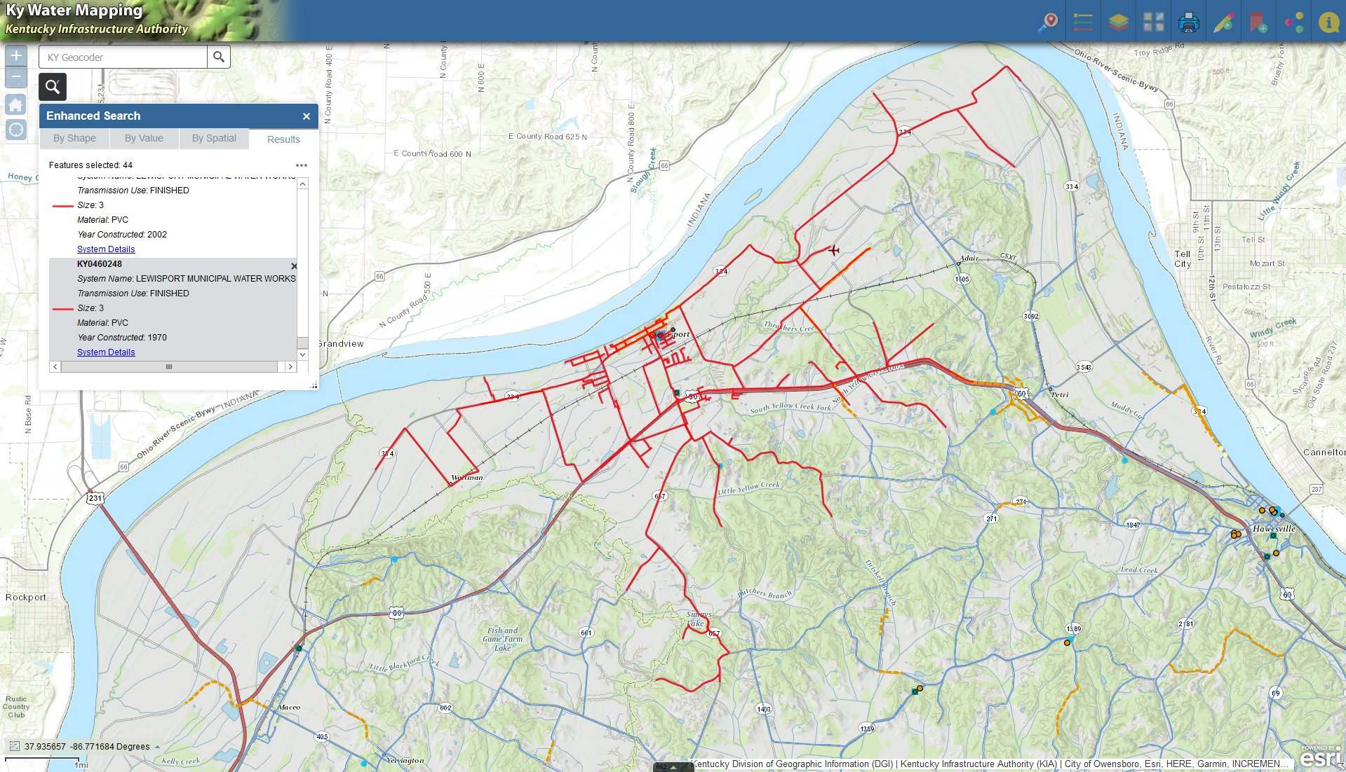

Slide 45
WRIS Portal: GIS
GIS Data Accuracy
For every system that has less than 10,000 serviceable population, the ADDs have GPS collected point locations that are not visible on imagery
Includes: Water/Sewer valves, hydrants, manholes, pump stations, intakes, outfalls, etc.
Lines are drawn using GPS locations, as-builts, and utility knowledge

Slide 46
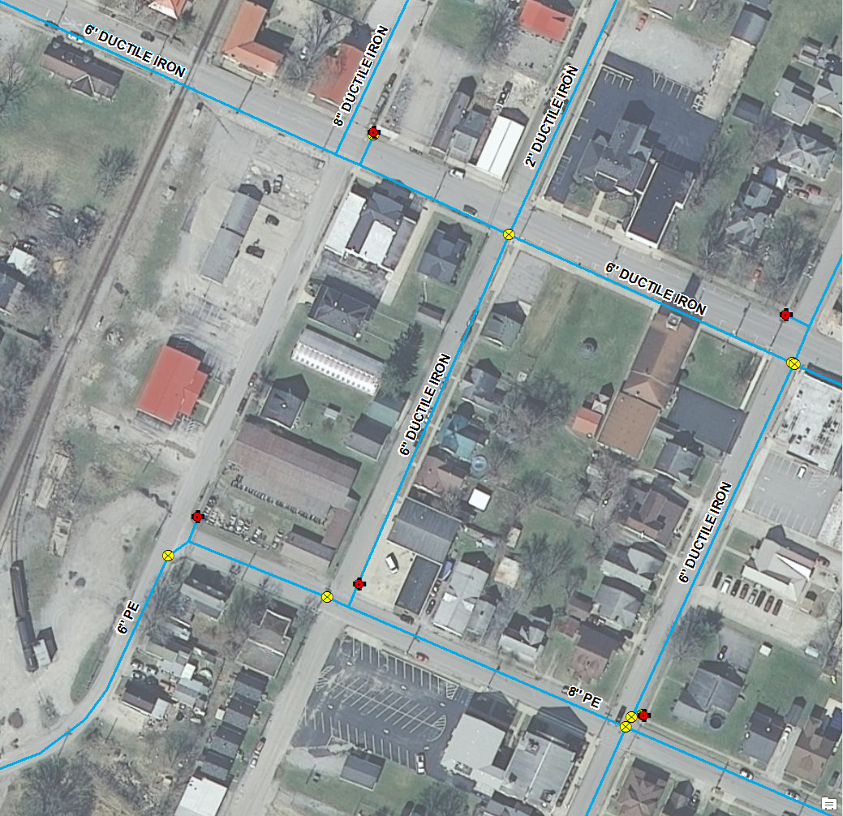
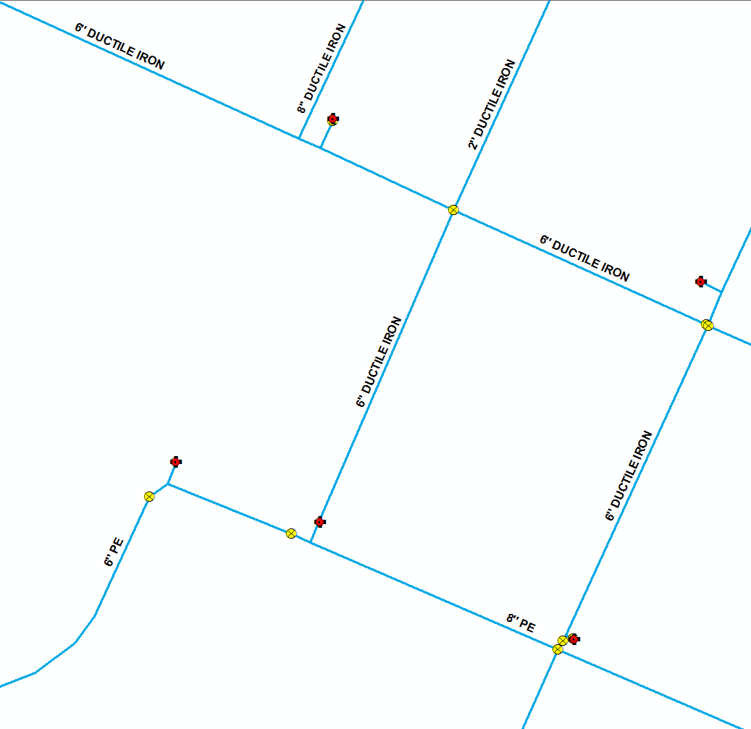

Slide 47
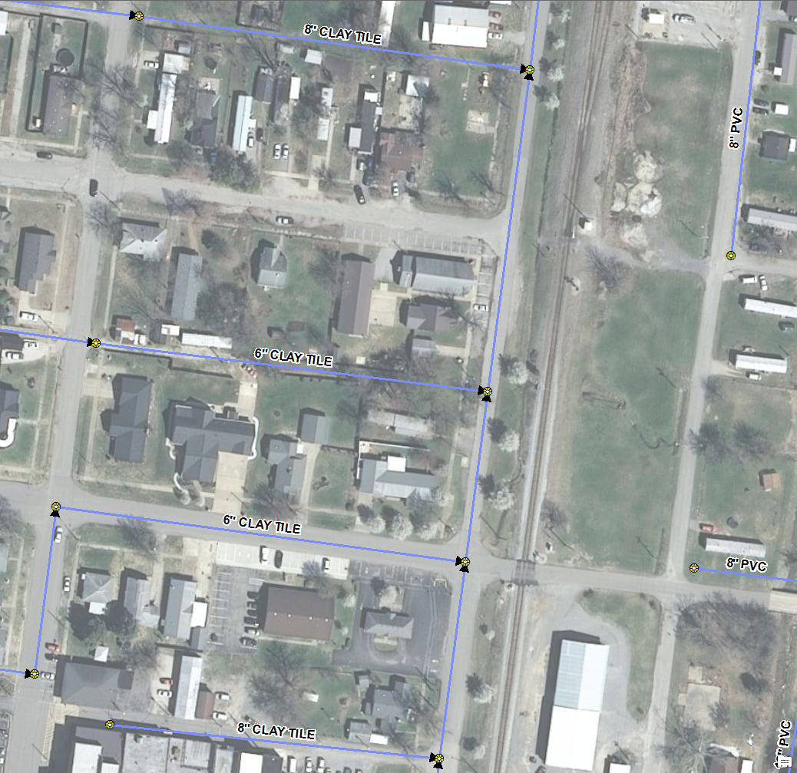
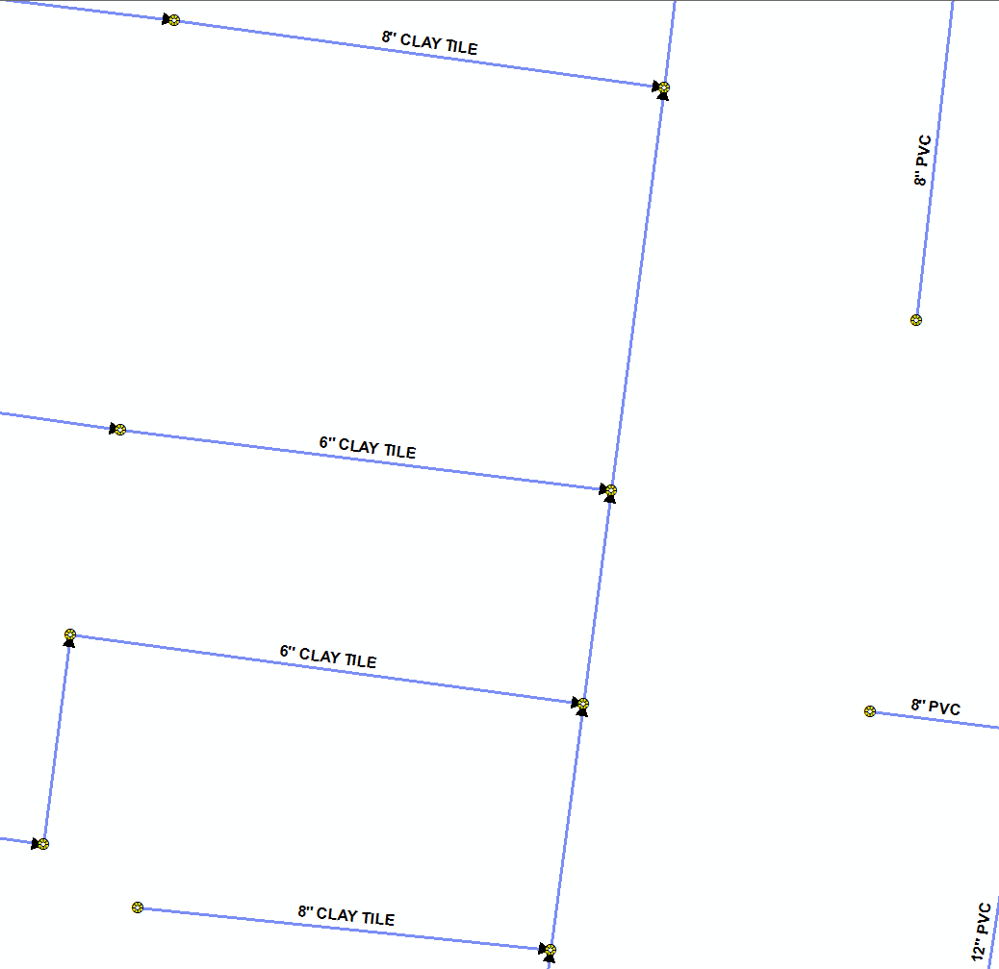

Slide 48
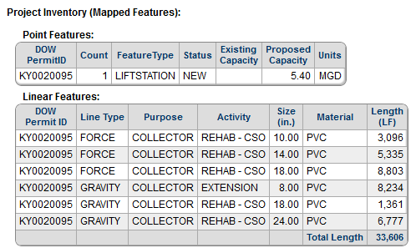
WRIS Portal: GIS
GIS Data Integration and Overlays
Mapping attributes are used to populate components TAB of a project profile
Mapping attributes are used to check various boxes within project profile
Specific components must be mapped for these items to check (Pre-App)

Slide 49
WRIS Portal: GIS
GIS Data Integration and Overlays
Datasets can be overlaid to perform analysis
Median Household Income Determination
The illustration to the right represents the service lines of a water or sewer system in orange and roads or highways in gray. Each square represents a census block and all of the census blocks are within a single census tract.
Datasets: WRIS SewerLine
WRIS WaterLine
US Census Blocks
KYTC Roads
Determine the Percent Serviceable HH for Each Census Block
Length of Service Lines ÷ Length of Roads = Percent Serviceable
(Within a Distance of Roads)

Slide 50
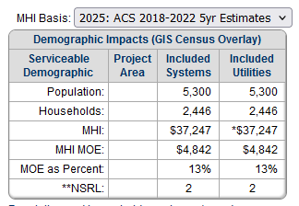
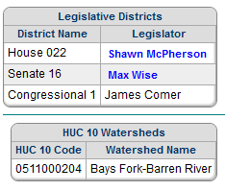
WRIS Portal: GIS
GIS Data Integration and Overlays
Examples of GIS data we use for analysis and visualization (external sources):
Impacts TAB
Census tracts/blocks
County boundaries
City boundaries
Legislative districts
HUC watersheds
Roads – KY Transportation Cabinet (KYTC)

Slide 51
WRIS Portal: GIS
How are the GIS public web maps and portal components updated?
Current Methodology Esri ArcMap 10.8.2
Disconnected Editing - Check-in/Check-out Process
Output is Personal Geodatabase (MDB and MXD)
ADDs have an opportunity to check-in their data twice a month
New Methodology Esri ArcGIS Pro 3.x
Output is File Geodatabase (FGDB)
Disconnected Editing / One-way / Two-way replication are options
Migration must be complete by March 2026

Slide 52
The WRIS is a Planning Tool!

Slide 53
Thomas A. Schubert
Geoprocessing Specialist III
502-892-3640
thomas.schubert@ky.gov
Don Schierer
Resource Management Analyst III
502-892-3486
donald.schierer@ky.gov
100 Airport Road 3rd Floor
Frankfort, KY 40601
https://kia.ky.gov

Slide 54
Key Acronyms
(KIA) Kentucky Infrastructure Authority
That’s us!
(DOW) Division of Water
(ADD) Area Development District
Regional quasi government agency contracted with KIA (15 in KY)
(WRIS) Water Resource Information System
Database developed to house system and project data
WRIS Portal is the web interface of the WRIS
(GIS) Geographic Information System
Mapping component that’s integrated into the WRIS
(GPS) Global Positioning System
Devices used to accurately map existing system features

